Slide 1
Bangladesh Army University of Engineering & Technology
Department of Electrical and Electronic Engineering
Final Defense of IDP-I/II
Title of Project
Presented By
(ID:XXXXXXXXXXXXXXXXX)
(ID: XXXXXXXXXXXXXXXXX)
(ID:XXXXXXXXXXXXXXXXX)
Supervised By
Mr. X,
Designation
Date: 4th June, 2024
Venue : Simulation Lab (Room No : 512P)

Slide 2
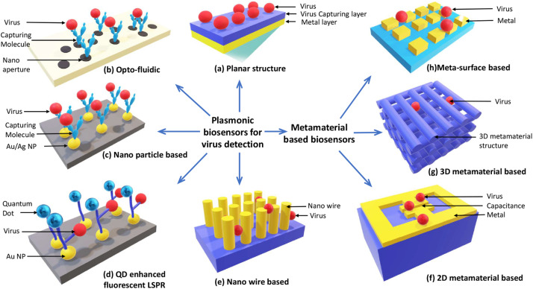
Outline
1
Introduction/Background
EEE 3100: Title of the Presentation
2
Review & Problem Statement
3
Objectives
4
Methodology
5
Project Design & Development
6
Noble Features of This Project
7
Milestone and Gantt Chart
8
Budget
9
Conclusion

Slide 3
Introduction
Give short introduction about your project.
Use font 32 or greater so that audience can easily read the text of your slide from far distance.
Use same type font Like Times New Roman/ Arial for whole slide.

Slide 4
Review of Existing Project
Write about the existing project related to your project.
Give proper citation of image/text that you have reviewed
Compare their features/nobility

Slide 5
Problem Statement
.
Write about the problem that you want to solve in your IDP project which has not been solved properly in existing project.

Slide 6
Objectives
.
Write clear and concise objective(s) of your project.

Slide 7
Methodology
.
In this section you can write description with proper model no of the modern/ tools/software/modules that you have used for project.
Explain different methods to develop the project

Slide 8
Project Design & Development
.
Give the hardware constructed model/simulation diagram
Explain process with flow chart/ bullet points
Give figure no and title properly

Slide 9
Noble Features of this Project
.
Write the key findings of your IDP project
If you give any data give it in tabular form

Slide 10
Milestone & Gantt Chart
.
Give your project milestone and Gantt Chart in Tabular form

Slide 11
Budget
.

Slide 12
Conclusion
.

Slide 13
References
.

Slide 14
Thank you

